Slide 1
Your Logo Here

Slide 2
TRADITIONAL APPROACH
Notes:
United Way of Snohomish County works with community partners to help local families with young children who are fighting to escape poverty. We believe the most effective way to achieve this goal is by focusing on systemic change, ensuring that families live to their fullest potential for generations to come regardless of race, place, and ability.
Traditionally, programs and services are largely either adult-centered or child-centered. Families face a network of services that are difficult to navigate with many confusing and complex roads to resources. The difficulty in navigating these complex systems, from education and healthcare to government assistance and community programs, can keep a family trapped in poverty.

Slide 3
CORE APPROACH
Notes:
CORE fundamentally shifts the conversation around poverty from a siloed system of services to a collaborative approach serving both children and the adults in their lives, together.
CORE places the whole family at the center of a collaborative partnership where multiple nonprofit, public, and private partners work with families who are fighting to escape poverty.
CORE uses two very promising national models: Collective Impact and a 2-Generational approach. The 2-Generational approach works to simultaneously meet the needs of the whole household and is not limited to only parents. For instance, at school, you cannot effectively meet a child’s needs without also supporting the various caregivers who take care of that child when they go home at night, on weekends, and in the summer.
This 2-Generational approach focuses on five core areas: early childhood education; postsecondary and employment pathways; health and well-being; economic assets like stable housing and savings; and community connections like friends, family, and other social groups for both the children and the adults in their lives.
Collective Impact brings partners together to significantly shift social issues through structured, measurable collaboration.

Slide 4
2020 IMPACT: COLLABORATIVES & COVID-19
Notes:
Like all of us, the CORE Collaboratives spent much of 2020 adjusting their work and supporting families through a year of lockdowns, virtual interactions, and social, emotional, and physical challenges no one has ever experienced. Here are the ways CORE Collaboratives responded to the COVID-19 pandemic.

Slide 5
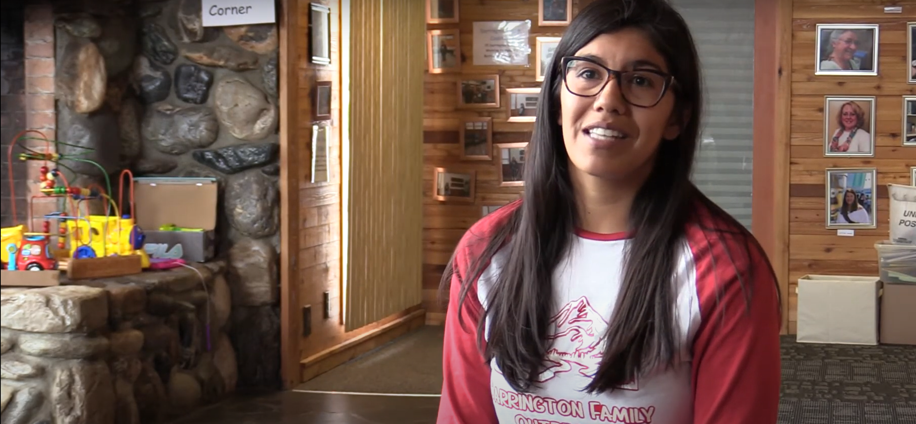
IN THEIR OWN WORDS: BETHANY
Notes:
In presentation mode, click the button to play the video. If you aren’t in presentation mode, ctrl+click to play.

Slide 6
Notes:
By supporting United Way of Snohomish County’s CORE work, you are helping develop innovative strategies to shift the focus from short-term fixes to long-term, lasting solutions for families in Snohomish County who are fighting to escape poverty.
Thank you for your generosity and commitment!

